Slide 1
Optional Subjects for 2nd year
This presentation was created by your teachers with information on your choices for optional subjects.

Slide 2
Choosing subjects
When choosing subjects you need to consider 2 main questions:
What subjects do you enjoy?
What subjects are you good at?
Please talk to your parents/guardians and also contact your teachers for advice if you are unsure

Slide 3
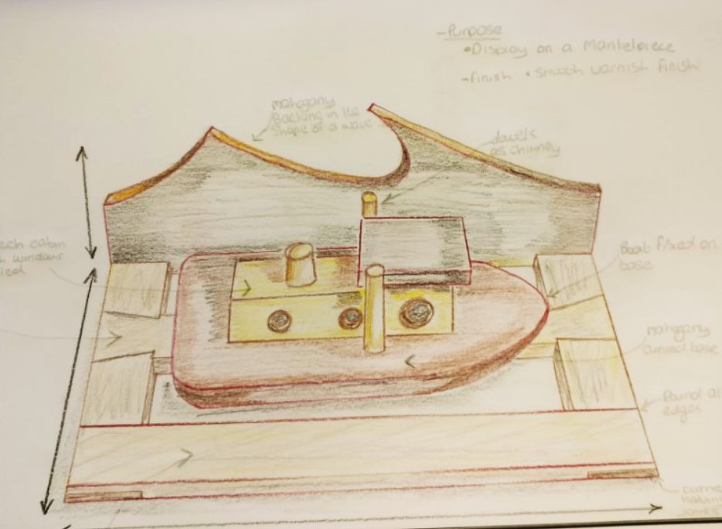
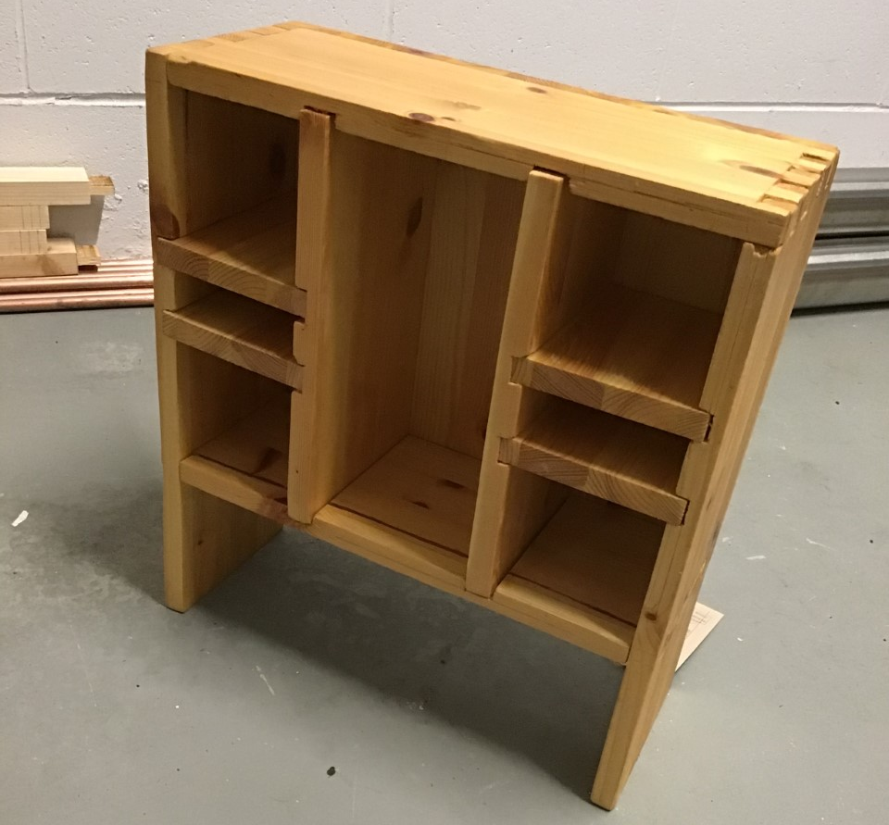
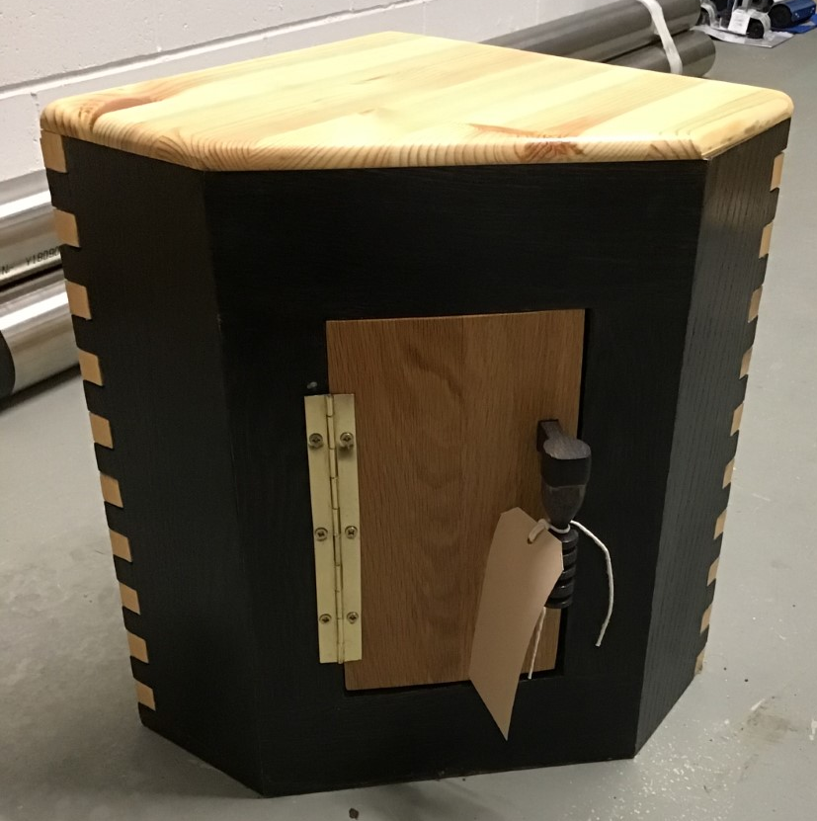
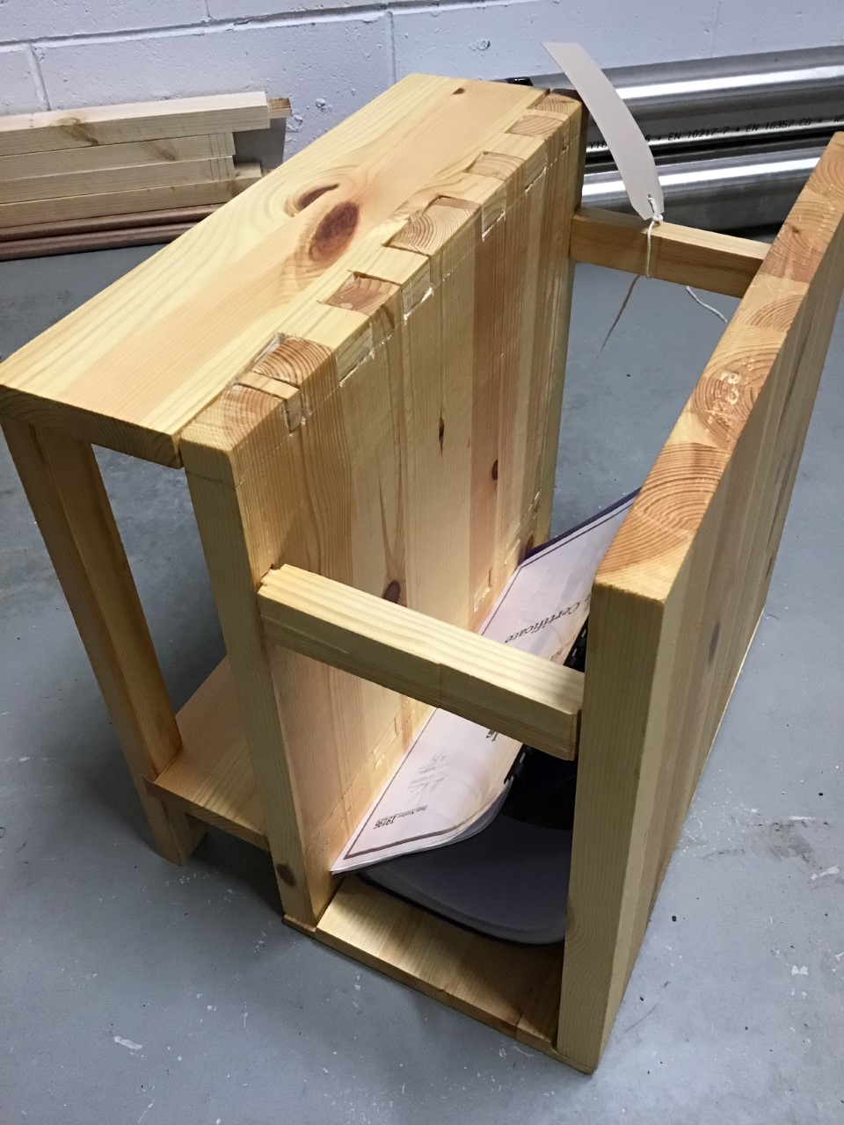
Woodwork
Examples of student work….
I should choose this subject if I like:
Working with dimensions and maths
Learning about how timber impacts our lives from seed to saw
Making things
Designing
Being creative
The main topics covered are:
Timber seasoning
Timber conversion
Hand tools/ Power Tools & Machines
Sketching
Practical work
This subject is assessed by:
30% exam in June of 3rd year
70% Project done during 3rd year

Slide 4
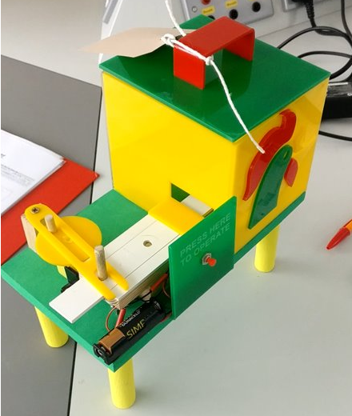
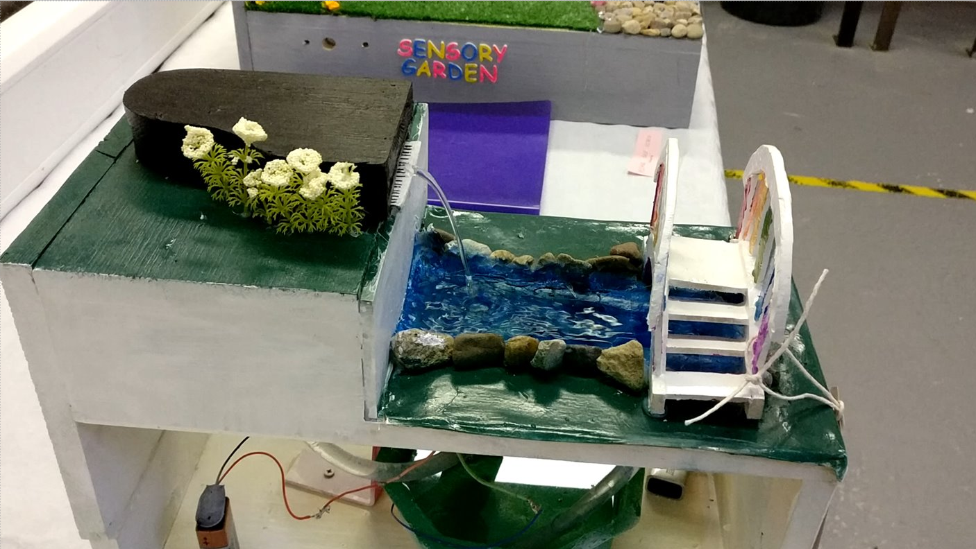
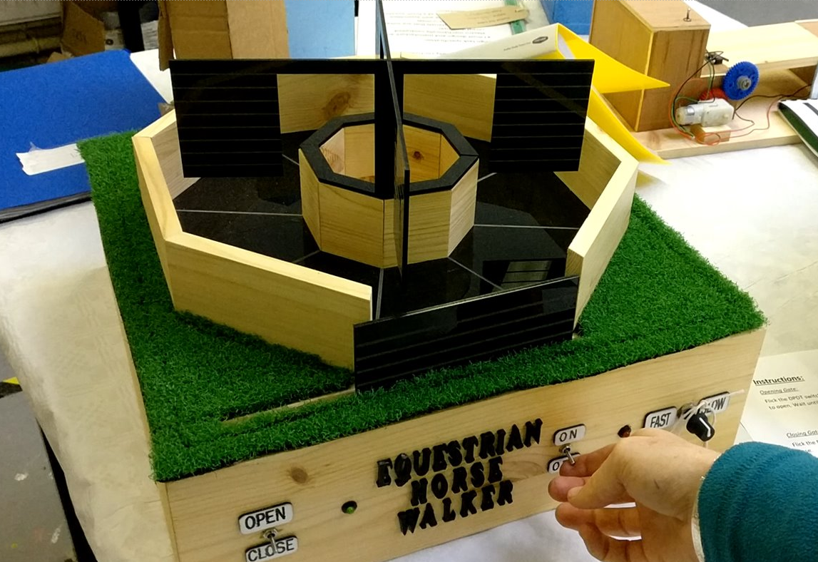
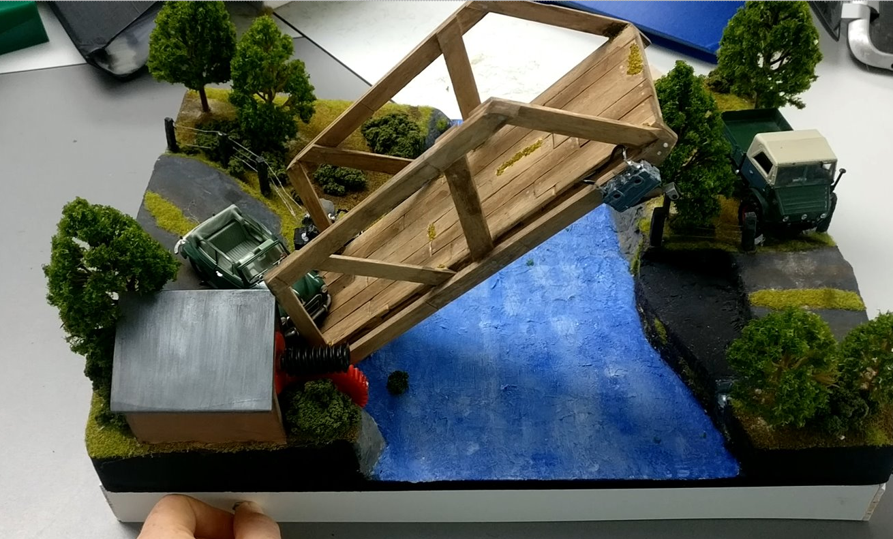
Technology
Examples of student work….
I should choose this subject if I like:
Learning how things work
Making stuff
Learning to solve problem
Designing
Being creative
The main topics covered are:
Electronics
Mechanisms
Designing then making
Sketching
This subject is assessed by:
30% exam in June of 3rd year
70% Project done during 3rd year

Slide 5
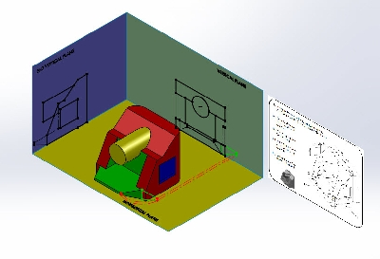
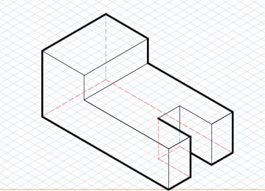
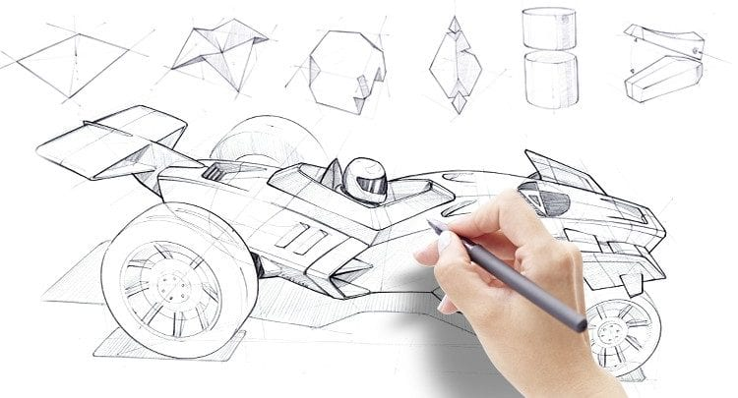
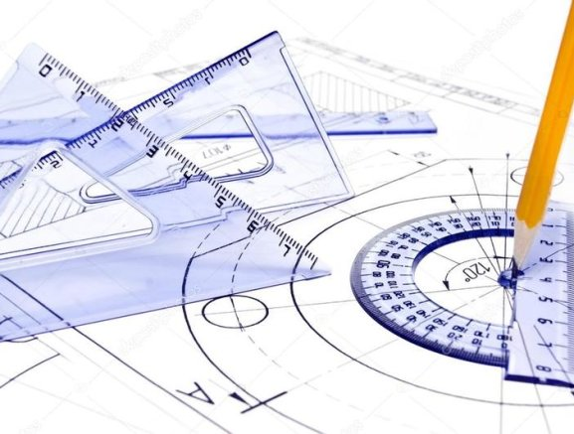
Applied Graphics (Technical Graphics)
I should choose this subject if…
You like Puzzles especially ones with shapes
You like drawing and designing
You like no typing or writing
You like maths like geometry
The Main Topics covered are….
Geometric shapes (how to draw different shapes)
Projection Systems (3d drawing and different views)
3d Modelling on Computers
Freehand Design and Architectural Sketching
Design and Innovation
The Subject is assessed by….
40% project Completed in 3rd year
60% Drawing exam.

Slide 6
Engineering
I should choose this subject if: I had a very strong interest and curiosity in technological machines, robotics and materials. This subject requires students to have an inquiring mind, an ability to research and design projects and the ability to carry out tasks to a high standard within a limited timeframe. Problem solving skills are a necessary attribute!
The main topics covered are: Engineering theory, manufacturing, design, electronics, science and maths.
This subject is assessed by: Short and long term project work, written portfolios, continuous assessment. A significant design and make project and a written examination are required at the conclusion of 3rd year.
Other relevant information if needed: Engineering students are required to be disciplined, hardworking and focussed individuals. Yet teamwork is of particular importance. Therefore, engineering students are required to make considerable contributions to solving design and manufacturing problems within the group.
Careers:
If you have a particular interest in a possible future career in engineering and design – you start here!

Slide 7
CODING & DIGITAL MEDIA LITERACY
I should choose this subject if I liked the coding taster but I’m also interested in using the internet to communicate news, video, photography and Audio.
The main topics covered are an introduction to web design, python, making apps, games, video, radio editing and Microsoft office programmes
This subject is assessed by:
This subject is assessed mainly through project work. Final assessment is with two CBA’s that are given in 3rd year.
Other relevant information if needed!
This subject differs from coding with KC+ in that there is less coding and more study of the positives and the hazards of online media and communication using the internet. In 2nd year you do 2hours of Coding per week and 1hour of Digital Media Literacy. In 3rd year you do 1hour of Coding per week and 2hours of Digital Media Literacy.

Slide 8
KISHOGE CODING +
I should choose this subject if I liked the coding taster and what to do as much coding as possible or are thinking of doing Coding for Leaving Certificate.
The main topics covered are: An introduction to web design, python, making apps, games, art through code, music through code, systems analysis, networking and electronics.
This subject is assessed mainly through project work. Final assessment is with a large CBA that is given in 3rd year.
This subject differs from Digital Media Literacy in that there is more emphasis on the theory of coding and creation of more complex programs rather than how to use a computer and photo, video, audio manipulation.
In 2nd year you do 3 hours of Coding per week and in 3rd year you do 3 hours of Coding per week.

Slide 9
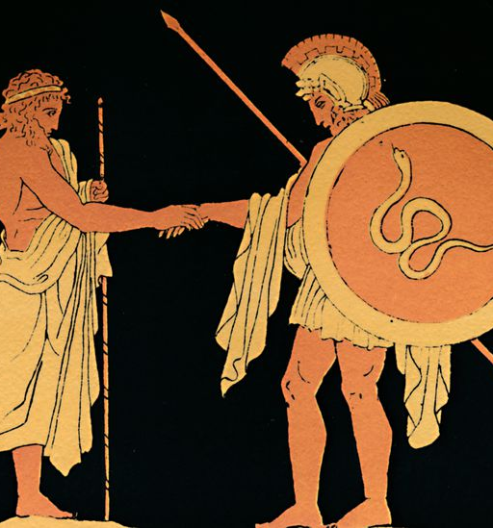
Classics
I should choose this subject if I have an interest in stories, people and ideas.
The main topics covered are:
The Greek myths and legends, heroes, gods and goddesses and some ancient history such as the gladiators.
This subject is assessed by:
2 CBAs (worth 10%) and one written exam at the end of third year (90%).
Other relevant information:
Lots of fun, creativity, discussion and critical-thinking. No textbook required.

Slide 10
Music
I should choose this subject if I like: being creative, using different types of software, learning about different cultures, history, listening to music.
The main topics covered are music composition, music listening, music history, performance.
This subject is assessed by 2 CBAs (1 composition portfolio in 2nd year, 1 programme note in 3rd year), a written and listening exam, and a performance.
Other relevant information: You do not need to already play an instrument but if you do already play one that’s brilliant. Its not just classical music.

Slide 11
Business studies:
I should choose this subject if: I want to learn about how businesses work. I like the idea of starting a business. I want to learn about why people buy items and how the prices are set. I like using numbers to find out information and examining data and research.
The main topics covered: Budgeting, Insurance, The Consumer, Accounting, Economics and Business Documents.
This subject is assessed by: 2 CBAs (1 in 2nd year, 1 in 3rd year) and an exam at the end of 3rd year which is worth 100% of your final grade.
A good understanding of maths is needed for the accounting sections of this subject. When studying Business Studies you will begin to see how global markets interact with one another and allow for use to be a more connected global economy.

Slide 12
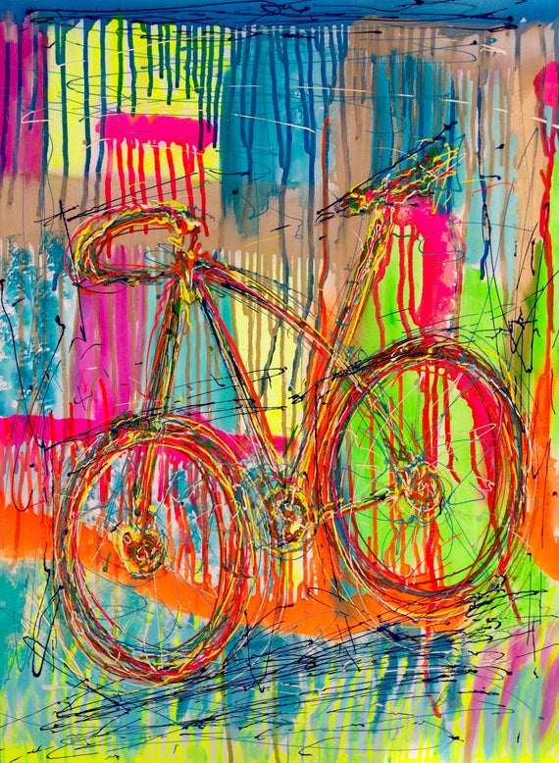
Visual Art
Visual Art is a very rewarding and enjoyable subject.
Art gives students the opportunity to develop their imagination and creativity.
Many of the skills you learn while studying Visual Art are very useful outside of school and in whatever job you choose to do in the Future
Career Opportunities: Game design, interior design, illustration, animation, photography, advertising, industrial design, fashion/costume/set design, artist, curator, education, and architecture.
In Visual Art you will learn:
To develop your observational skills through drawing and painting
A variety of new crafts and skills (printing, calligraphy, painting, creative embroidery, batik)
How to work in 3-D e.g. construction, sculpture or clay work
How to make links between your artwork and that of other artists, craft workers, architects and designers from different countries and historical periods.
Assessment
There is no written assessment in Visual Art for the Junior Cycle. It is project-based assessment only. There is a CBA 1 project to be completed in 2nd Year, CBA 2 project at the beginning of 3rd Year and another large project to complete from January in 3rd Year

Slide 13
Taster Subject name: Home Economics
I should choose this subject if – 1.I want to improve my cooking skills 2. I want to learn about Health, Nutrition & family living
The main topics covered are- 1. Food, Health & Culinary Skills
2. Family Living
3. Textiles & Craft
This subject is assessed by 50% cooking exam/50% Written Exam
Other relevant information if needed
-As cookery is worth 50% of the overall mark, we will aim to cook every 2 weeks. Students need to supply their own ingredients.
- Home Economics develops students' practical food and health literacy skills so that you are enabled to adopt a healthy lifestyle and make informed decisions that positively impact your health and wellbeing

Slide 14
Chinese Language & Culture
Potential benefits of studying Chinese Language and Culture:
Being among the first Irish students to study the most spoken language in the world
Acquiring an understanding of an ancient world culture · Acquiring the ability to speak Mandarin Chinese
Opening up the possibility of studying the language at university
Enhanced employment prospects. It is likely that the ability to speak some Mandarin and to understand Chinese culture will be highly regarded by employers for many years to come Chinese Language & Culture in Kishoge CC
The course will be taught by fully-qualified Chinese native teachers who will also be teaching in Maynooth university · Mandarin Chinese is not yet an exam subject so students will not sit it as part of their Junior Cycle. However, students will sit the Youth Chinese Test, Chinese government exams, at the end of Second and Third years.
· From 2020 Chinese is being offered as a full Leaving Cert subject. Ten Kishoge CC students will be among the first students in Ireland to sit this exam in 2022.

Slide 16
You and your parents/guardians will be contacted by the school as to when and how you will pick your subjects.

