Slide 1
CAO and Future Options Parents Information Evening 2023

Slide 2
Topics covered
The CAO process for college/university applicants
Exemptions – Irish/3rd language
HEAR – Higher Education Access Route
DARE – Disability Access Route to Education
Post Leaving Cert (PLC) college courses
Studying Abroad
Apprenticeships
SUSI Finance Grants

Slide 3
Guidance
Students get weekly career updates via email
Parents can access via website – Useful Links – LC Guidance Updates
LC Guidance Updates — Kishoge Community College - Coláiste Pobail na Ciseoige (kishogecc.ie)
College Talks
Expo visits
Drop-in clinics at lunch (Mondays and Thursdays)
Guidance classes
Career meeting 1-1 with guidance counsellor
Study Skills workshop
Open days
Student Wellbeing

Slide 4
What is the CAO?
What is the CAO?
Central Applications Office for applications to 3rd level higher Education (level 6,7,8 courses) colleges/universities in Ireland
What do they do?
The CAO process all the applications, they issue offers of places and then record acceptances for the colleges to their undergraduate courses

Slide 5
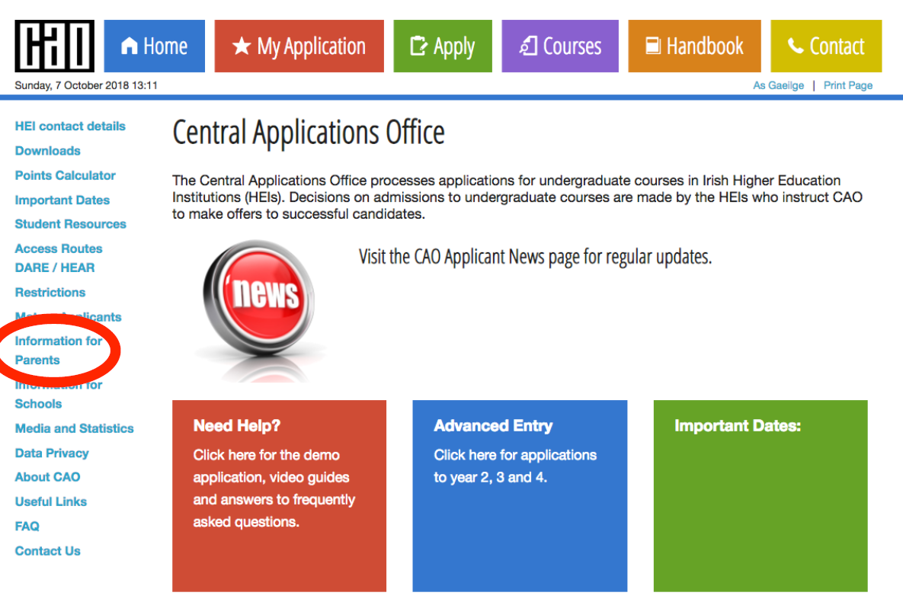
CAO HANDBOOK
Now only digital copies available
Section 1 - all the information needed to explain CAO process
Section 2 – lists all available CAO courses (level 6,7,8)
www.cao.ie
Parents section on website
Central Applications Office (cao.ie)
Handbook can be downloaded:
Central Applications Office (cao.ie)
All relevant links also on student OneNote/LC Guidance Updates on website.

Slide 6
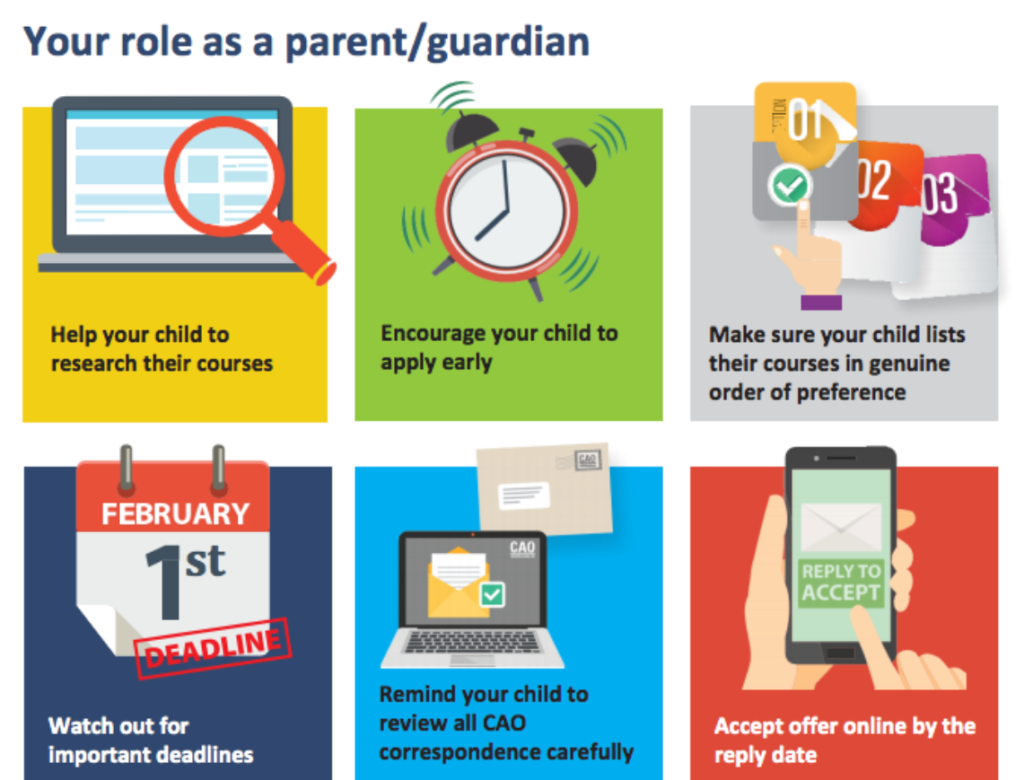

Slide 7
Example CAO Colleges/Universities in Surrounding areas
NUI Maynooth
DCU – Dublin City University
UCD – University College Dublin
TCD – Trinity College Dublin
TUD – Technological University Dublin
NCAD – National College of Art and Design
NCI – National College of Ireland
RCSI – Royal College of Surgeons Ireland
Dun Laoghaire Institute of Art and Design

Slide 8
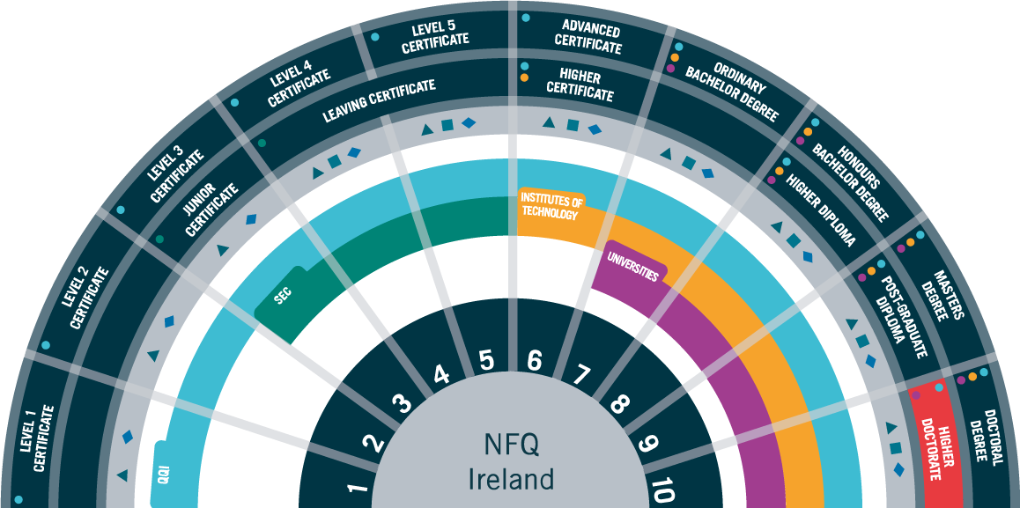
National Framework of Qualifications
CAO deals with Level 8 and Level 6/7 Degrees

Slide 9
Sources of Information
CAO Handbook – www.cao.ie
Guidance Counsellors/Teachers
Useful Links
www.careersportal.ie
www.qualifax.ie
www.accesscollege.ie (Hear/Dare)
www.ucas.com (applying to UK)
www.eunicas.ie (applying to EU)
www.susi.ie (Grant Information)
Open days - College visits
College Talks in school (TUD, DCU, UCD, Maynooth etc)
Current students / graduates

Slide 10
Golden Rule....

Slide 11
Criteria to Access College/University
Offers made based on 3 Entry Criteria
1. Minimum Entry Requirements
Most degree courses require minimum 2 H5 and 4 O6 / H7. TCD requires a Minimum of 3 H5.
Colleges require different requirements e.g. a pass in certain subjects such as English, Irish, Maths and a 3rd language (e.g. Spanish/ French etc)
2. Faculty requirements
Some courses may have higher grade requirements in specific subjects such as H4 in Maths for many Engineering courses or H4 in Irish for Primary Teaching - Students check these on qualifax.ie/Careersportal.ie or individual college websites)
and
3. CAO Points
Calculated from 6 Best subject results (25 Extra for Honours Maths)
2022 and 2023 Points for all Courses Available (careersportal/qualifax) Points change each year depending on popularity

Slide 12
Top 6
Results
Count
Top possible points
625

Slide 13
Applying to the CAO
1. Register at www.cao.ie (blank sample form on Onenote/ Demo application on CAO.ie)
2. Students receive CAO number and verification code for logging into ‘My Application’ on cao.ie
3. Students select up to Ten Level 8 Courses and Ten Level 6/7 Courses
4. Choices should be listed in order of preference
5. Changes to courses and preferences can be made up until July 1st (access closes between Feb 1st and May 5th)
6. Restricted courses can not be added after Feb 1st – ie. courses that require Portfolio, Audition or Interview (or HPAT for medicine)

Slide 14
Level 8 |  |  | Level 6/7
Pref | Course Code |  | Pref | Course Code
1 | CK101 |  | 1 | BN003
2 | DC201 |  | 2 | TA102
3 | AL033 |  | 3 | TA101
4 | DN021 |  | 4 | NC101
5 | TR084 |  | 5 | TA108
6 | DC115 |  | 6 | DT315
7 | DT366 |  | 7 | DT521
8 | BN101 |  | 8
9 | DT413 |  | 9
10 | PD101 |  | 10
Listed in genuine
order of preference!
Dream Courses
Realistic courses
Safety Net Courses

Slide 15
How Places are Allocated?
When Leaving Cert examination results are released in August/September they are entered into the CAO computer.
The computer checks each applicant’s results. For each course the applicant has applied for, the computer first determines if the applicant has the minimum entry requirements/facility requirements for the course.
Notes:
15
15

Slide 16
How Places are Allocated?
All eligible applicants are then placed in a list, in order of the points they achieved, for each course that they applied for.
Notes:
16
16

Slide 17
How are places allocated?
The colleges then tell CAO how many places are to be offered on each course.
CAO then makes offers to the required number of applicants on each course starting with the applicant with the highest points and working down until enough places have been offered.
Students can get an offer from both lists i.e. level 8 and level 6/7 but can only accept 1 offer
Students should accept this offer – as they might receive a higher offer in round 2, but they can never go lower
Notes:
17
17

Slide 20
Genuine Order
of Preference
You do not need to guess what the points are going to be for the courses you are interested in.
Simply list your courses in genuine order of preference from the highest preference 1, to the lowest preference 10.
If you are entitled to an offer, you will be offered the highest preference that you are entitled to.
Notes:
20
20

Slide 22
Important Information
Applicants for DARE and HEAR schemes - must tick the box as part of the online CAO Application and complete this section. They will need your help with this.
Parents must post all supporting documents for DARE and HEAR to the CAO (address in handbook) by March 15th. E.g P21, social welfare form etc.
Financial Grant Applicants through SUSI should also tick a box in CAO online application - apply separately susi.ie.
SUSI does not open until mid April 2024

Slide 23
Exemptions from Minimum entry requirements
Irish is required as a basic entry requirement for a lot of courses in the following colleges Maynooth University, UCD, UCC, NUIG, RCSI, NCAD
Students may be eligible to apply for an exemption for minimum entry requirements only. They must still study Irish in school
Students with a school exemption (specific learning disability) will generally get one at 3rd level but must apply.
For any student born outside of the Republic of Ireland they can apply for an NUI Irish exemption for minimum entry purposes.
Irish is not required for other colleges such as DCU/TCD/TUD. TCD has its own language waiver form.
How to apply:
Submit a Language Exemption now ONLINE only directly to the NUI
NUI Matriculation - Application for Exemption
Matriculation FAQ's | National University of Ireland (nui.ie)

Slide 24
Common Errors
Not enough research into courses
Listing courses in order of points instead of genuine preference
Underestimating / overestimating Leaving Certificate results
Targeting low point courses in hope of getting College place
Targeting Level 8 courses only and ignoring Level 7 & 6 courses
Not considering courses outside certain geographic areas

Slide 25
Dos / Don'ts of CAO Applications
Do choose ten options if at all possible
Do list courses in order of genuine preference
Do make sure to have other options if you do not get your preferences e.g. PLC course
Do check Alert Lists on CAO website

Slide 26
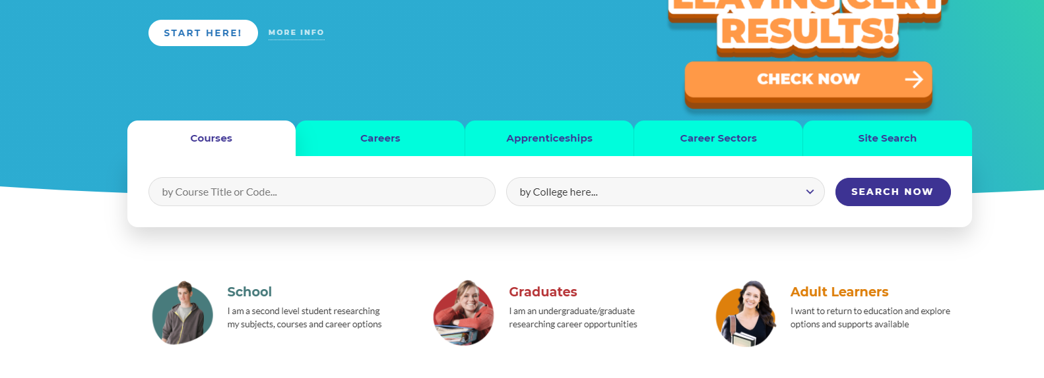
Searching on careersportal.ie - Demo

Slide 27
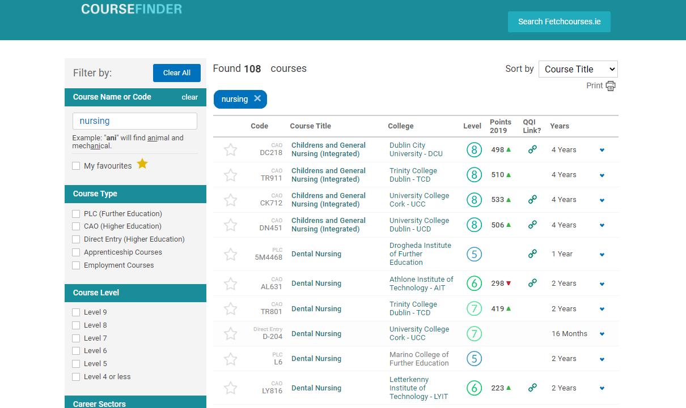

Slide 30
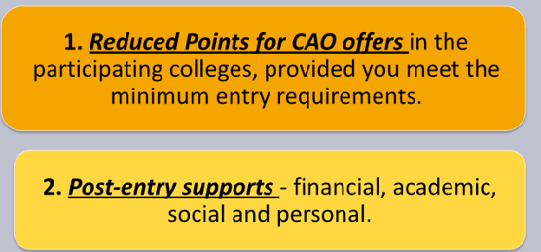
An example: If the Leaving Certificate points for a course are 366 points, an eligible HEAR applicant could be offered a place with a lower points score e.g. 356 points.
Applicants need to meet entry and programme requirements to be considered for a HEAR reduced points offer.
The amount of points a particular course is reduced by is dependent on:
The overall number of places on the course
The number of reserved HEAR places on the course
The number of HEAR eligible applicants competing for these reserved places.
The reduction in points for HEAR places can vary every year.
For many colleges such as UCD, Maynooth, DCU students would need a minimum 300 points to be eligible

Slide 31
You need to meet a combination of factors e.g 1+2 and 3,4,5
Should I apply to HEAR?
1. Was your household income on or below €46,790 in 2022?
2. Do you or your family have a Medical Card/GP Visit Card that was in date on 31/12/2023?
3. Did your parents/guardians receive a means-tested social welfare payment for at least 26 weeks in 2022?
4. Is your parents’ or guardians’ employment status underrepresented in Higher Education?
5. Have you attended a DEIS second level school for five years? ( KCC is not a Deis school)
6. Do you live in an area of concentrated disadvantage?
Pobal HP Deprivation Indices

Slide 32
All students have a comprehensive PowerPoint on HEAR/DARE on their OneNote
Must apply for HEAR on CAO website by 1st March. (CAO deadline 1st Feb)
All documents need to be with the CAO no later than 15th March 2024– start gathering required documents as soon as possible
Further information and all handbooks can be found on the following link: www.accesscollege.ie
Application Guides, Resources and Forms - Access College

Slide 33
Last years presentation HEAR Application Information Session 2024 will take place online on Saturday 13th January 2024.

Slide 34
What is DARE?
The Disability Access Route to Education (DARE) third level alternative admissions scheme for school-leavers whose disabilities have had a negative impact on their second level education.
DARE offers reduced points places to school leavers who as a result of having a disability have experienced additional educational challenges in second level education.

Slide 35
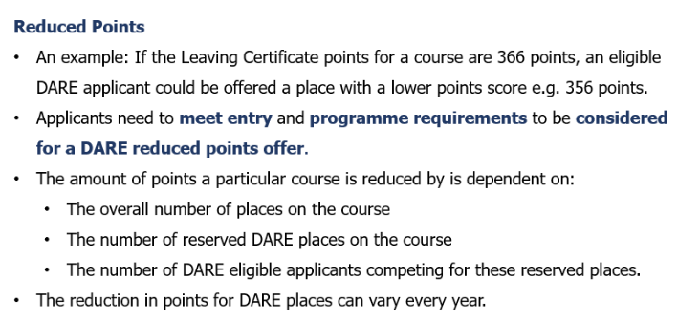
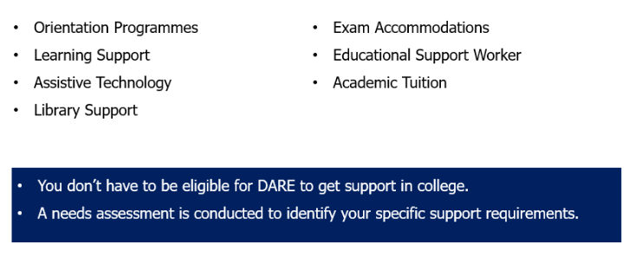
Benefits of DARE

Slide 36
Disabilities eligible for consideration
Autistic Spectrum Disorders (including Asperger’s Syndrome)
ADD / ADHD
Blind / Vision Impaired
Deaf / Hard of Hearing
DCD – Dyspraxia
Dyslexia/Significant Literacy Difficulties
Dyscalculia/Significant Numeracy difficulties
Mental Health Condition
Neurological Condition (Incl. Brain Injury & Epilepsy,)
Physical Disability
Speech & Language Communication Disorder
Significant Ongoing Illness

Slide 37
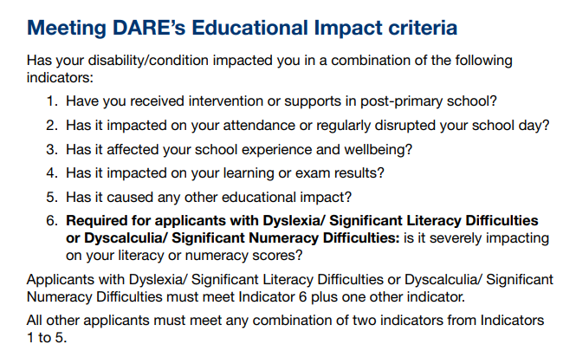
Educational Impact
Has your disability impacted on a combination of the following?

Slide 38
DARE Eligibility Criteria?
To be eligible for DARE you must meet both the DARE educational impact criteria and DARE evidence of disability criteria.
Applicants must provide the required evidence of their disability and provide an Educational Impact Statement from their school to be considered for DARE.

Slide 39
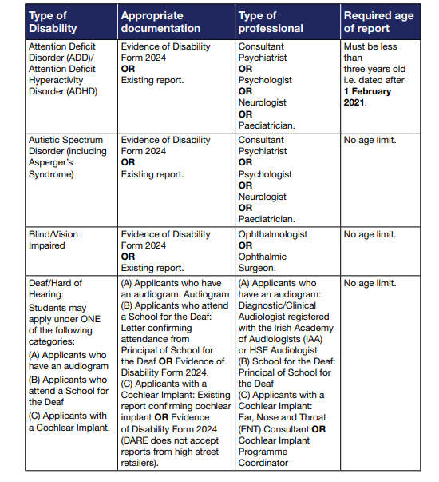

Slide 40
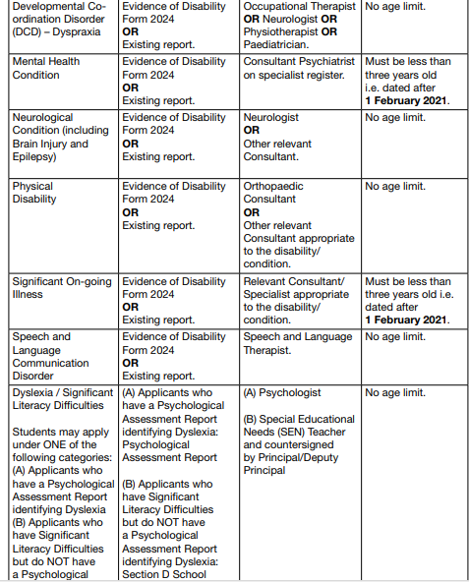

Slide 42
Supplementary Information Form (SIF)
Section A: Application Information (personal statement on impact of disability on schooling)
Completed by student by 17:00 on 1st March 2024
Section B: Educational Impact Statement
Educational Impact Statement completed by your school and send to CAO to arrive by 17:00 15th March 2024
Section C: Evidence Of Disability
Completed by the appropriate professional. Send to CAO to arrive by 17:00 15th March 2024
Section D: School Statement
Where applying under the Dyslexia/Significant Learning Difficulties category, applications who do not have a Psychological Report identifying Dyslexia should submit Section D. Send to CAO by 15th March 2024

Slide 43
Section A – On CAO – Completed by Student

Slide 44
Link to all DARE Forms
Central Applications Office (cao.ie)
DARE Handbook
DARE-2024-Handbook-WEB-NEW.pdf (accesscollege.ie)
Application Guides, Resources and Forms - Access College

Slide 45
Last years presentation- The DARE Application Information Session will take place 13th January 2024

Slide 46
Remember…
You can apply to both DARE & HEAR
Applicants who are both DARE and HEAR eligible will be prioritised by colleges when allocating reduced points places.

Slide 47
Post Leaving Certificate Course – Colleges of Further Education
Separate to CAO -Usually at level 5 but some offered at level 6 (1 or 2 years)
Do not require leaving cert points
Minimum entry requirements are usually 5 passes in OL Leaving cert and an interview
Are now free as the 200 euro fee has been abolished but many have additional “course charge”
PLC can be used to access CAO courses (instead of LC results) or as a route straight to the world of work
Amazing variety of courses – can apply to individual PLC college or now via FE tab on CAO website

Slide 48
Who is PLC for?
Students not ready/unsure about college
Students who want to access college through the “Higher Education Links Scheme”
Want to discover a vocational(work) area of interest
Small class sizes
Leaving Cert Applied students
Most PLC courses have 8 modules and you would need at least 5 distinctions to use this award to progress into college
Some places are very competitive so you might need up to 8 distinctions

Slide 49
UCAS
UCAS – Applications site for studying in the UK
16th October - Deadline for Medicine; Veterinary Medicine or Dentistry (require UCAT/MBAT exam)
31st January 6pm – all other courses
Students will also need a reference and predicted grades submitted by a teacher
Most degrees in England, Wales and Northern Ireland have tuition fees of £3,500 to £9,000 sterling per year.
Some funded courses in NI e.g. Nursing, physio, Occupational therapy
Can apply for UK student finance but will have to repay loans once start earning
UCAS | At the heart of connecting people to higher education

Slide 50
1200 undergraduate programmes are now taught through English in European Universities
European fees – there are no fees in Scandinavian countries and low fees in counties such as Germany, Austria and the Netherlands
Often lower entry requirements
Each college has different entry requirements and policies and a lot of research is needed.
Can apply via www.eunicas.ie (38 euro fee to help with application for up to 8 universities in Europe)

Slide 51
Get paid while you train (Electrician in 4th year earns 720 a week)
Mix of on the job training and college/training
Traditional apprenticeships – electrician, carpenter, plastering plumbing, mechanic, engineering etc
New apprenticeships – Finance, healthcare, Lab technician, accounts technician, sales, software developer, auctioneering and property etc – new apprenticeships have various entry requirements
It is up to the student to secure an apprenticeship
All can be viewed at the following link:
https://apprenticeship.ie/

Slide 53
Applying to SUSI
SUSI will not open for 2024 applications until mid April next year
Most of the information on the SUSI website is for the 2023/2024 academic year
There have been BIG changes in the 2024 budget
SUSI is awarded on household income and will be based on the calendar year 2023

Slide 54
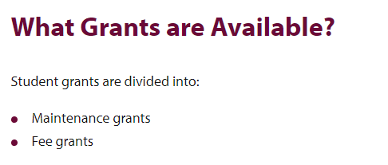
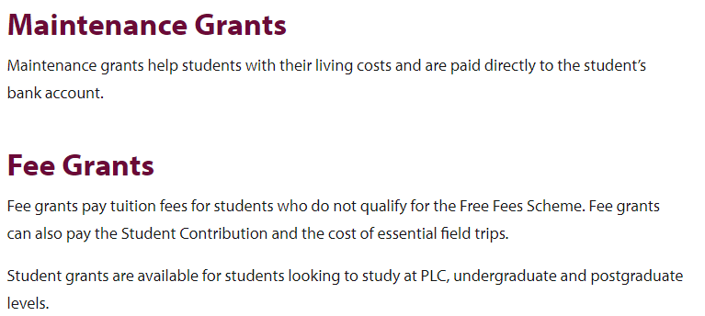

Slide 55
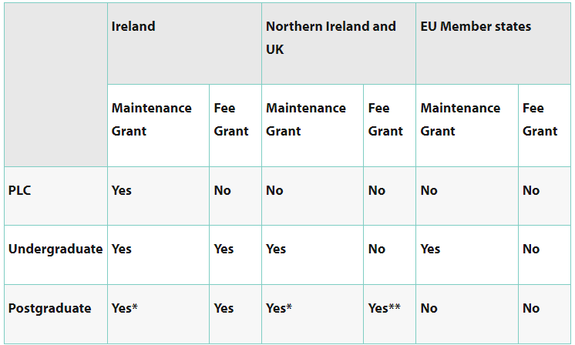

Slide 56
Special Grant Rate
If family income is under €25,000 and in receipt of an income protection payment for 391 days
Student can receive a double maintenance grant payment

Slide 57
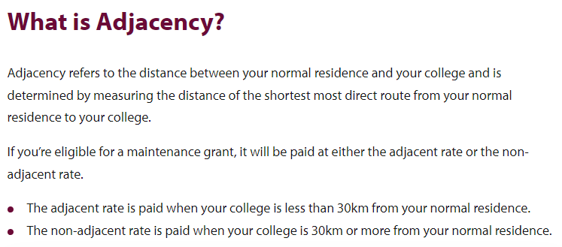
Maintenance Grant

Slide 58
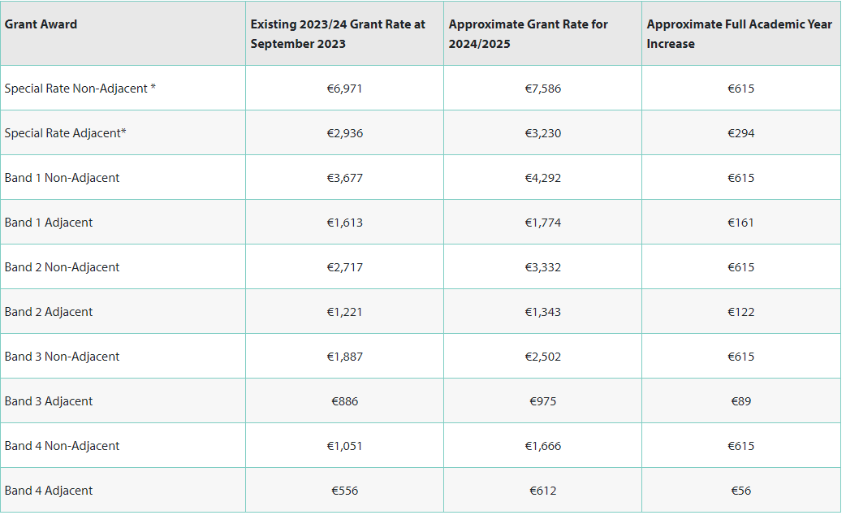

Slide 59
SUSI current thresholds
Undergraduate Income Thresholds and Grant Award Rates | SUSI

Slide 60
Budget 2024
Income threshold to receive band 4 maintenance is €50,840 (increased from €46,790 last year)
Income threshold for 100% student contribution grant (fees) is €55,924 (increased from €50, 840)
* income threshold to be eligible for various SUSI grants can change each year

Slide 61
To check if you are eligible visit https://susi.ie/eligibility-reckoner-app-irish/index.html
Can bring maintenance grant to UK/EU
Based on household income and number of dependants ( children under 16 or those in full time education or deemed medically unfit for work)
In separated families income threshold will be based on the parent the child lives with (maintenance is included in income)
Students are allowed earn up to €6,552 for Holiday Earnings
Apply mid -April 2024 on SUSI.ie – students will need parental help

Slide 62
Advice to parents
Keep an open mind about courses
Many of the jobs of the future haven’t even been invented yet
Students should pick something they enjoy
Many of the large companies don’t mind what your degree is in as they run graduate programmes
There are always alternative routes into various careers

Slide 64
Irish Times Parent Letter
My daughter isn’t sure what course to apply for. How can I help?
‘While all of this can feel daunting, there should be no need to feel anxious. Your daughter is not necessarily selecting a career at this stage; she is in the process of deciding which courses represent the best fit in terms of her interests, aptitudes and ability over the coming years. If she gets that step right, the career journey will fall naturally into place in the years ahead’

